Slide 1


s

Slide 2

APR
07
APR
08
09
10
JUN
11
DEC
s
DEC
JAN
12
FEB
13
14
MAR
15
SEP
SEP
DEC
16
DEC
MAY
17
MAY
18
FEB
19
FEB

Slide 3
Notes
3 moments of Chef in Chelle’s half of the story.
Apprehensive with Em watching – from her perspective, they hated each other.
Writing still to do.
1 moment showing Michelle’s reckless nature
1 interaction hearing how others talk about her mom
Her and her mom interact
Night her mom reveals letters
Chef and his brother interaction (with Chelle of Amilia)
Chef finds Em distraught
Em in the city
Coffee shop scene with Clarence, Amilia, Michelle and Chef
Amilia’s mom breaks down
Amilia’s mom apprehends her for her clothing
Em says goodbye to her dad
Hide and seek
DDR
Duck Hunt
Boss battle
Pokemon esque – choose from list – list becomes cry.
Isai / Masai
Consider 3D platforming – probs not necessary.
Horhey luiu borfez? Math obsessed novelist. Infinite library for tone.
Echo – game in infinite palace. Robots learn from your actions.
Enemy that replicates one’s actions – not even necessarily an enemy.
Consider cutscening the failure.
DDR about skill – similar to how her failure is not a reflection of herself – it’s her mother. Move where the failure comes from onto the mother. Ranking system.
What remains of Edith Finch – the Making of video.
Why arcades?
Go get your fonts. Use larger fonts for the digital elements.
Goals: 1st page blocked out, possible AR test.
Barcodes and prices for printed comic.
How would we pitch this as a kickstarter? How does it stand out online? Make a brand.
USE INSTAGRAM.

Slide 4
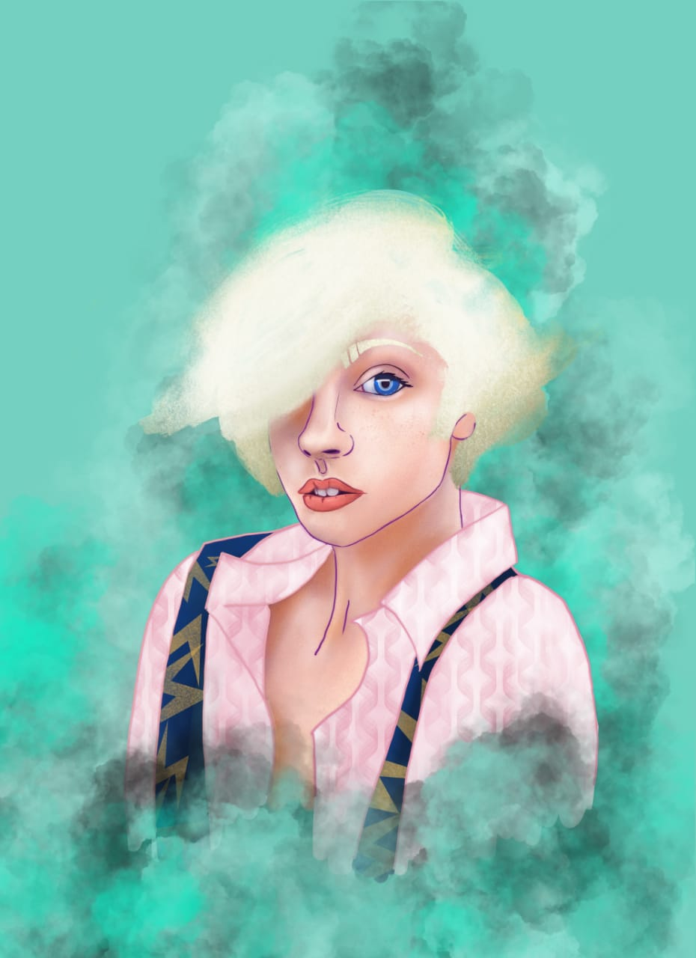
Amilia (Em)
Pale hair – probably white. Often shown with light clothes and red accents – implying her powers.
Incredibly powerful eidolin, trained by her mother and various coaches from a young age. She has incredible fire powers controlled through dancing.
Character is initially very submissive, following her mother blindly, but the pressure her mother keeps pushing on her soon leads her to rebelling.
She loves Chelle – or she did at some points in her life at least. When Chelle leaves, she’s devastated. This sparks her final transformation into a rebellious character.
Once Chelle leaves, she reaches out to Chef, ultimately ending up dating him.
After finding out how deeply he’d been manipulating her, Em decides to run away from home as well in search of Michelle and the free life she described in the city.
She spends the next few months dodging her responsibilities as a powerful figurehead in the eidolin community. She’s followed by a man determined to bring her home, but is too powerful to be forced home by him. His constant presence is very frustrating for her.

Slide 5
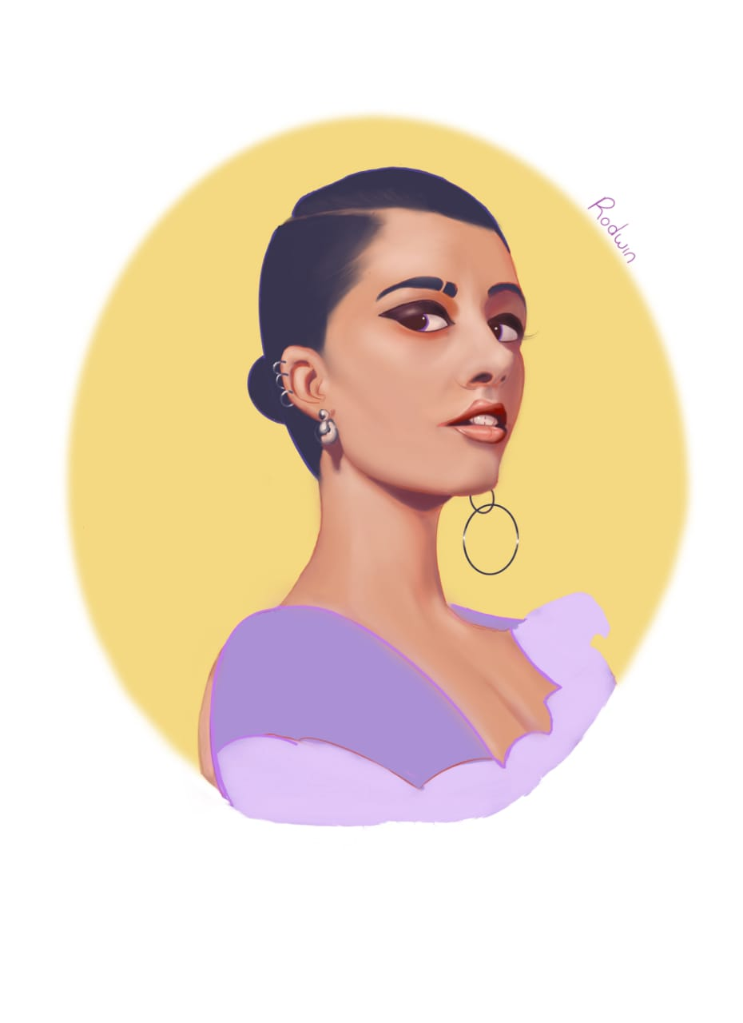
Michelle (Chelle)
Darker hair – initially short and later worn in a long braid. Chelle is half Indian and half Caucasian.
She’s particularly rebellious at a younger age, and lives her life as freely as the wind – reflecting her eidolon powers. She can create and manipulate air currents by singing.
She is close friends with Michelle and Clarence, but the majority of the town shuns her – calling her mother a harlot.
Her mother is hardly at home, focussing on her own life rather than her daughter’s. She’s still trying to find love, and hardly provides food and attention for Chelle. This is why she acts out – it’s a plea for any kind of attention.
In contrast, her father (divorced from her mother) lives in the big city. He’s living this amazing life, which he describes in letters to Chelle. In contrast to her mother, her father seems perfect, and so she idolises him.
The last time she saw him was when she was XXXX years old. In truth, this was the last time he ever contacted either her or her mother. The letters were written by her mother in hope of giving her daughter someone to look up to while she couldn’t be there.
Finding this out leads Chelle to the city to find the answers for herself. In the city, she loses her own understanding of who she is, causing her to slowly fade away – literally, due to her strange powers. She changes from her feisty, rebellious self, becoming more submissive and insecure (contrasting Em’s development).
As a person in general, she is sly and witty – often toying with people. She truly does find comfort in her friends Em and Clarence, eventually dating Clarence. When she does leave, she couldn’t bring herself to tell either of them.

Slide 6
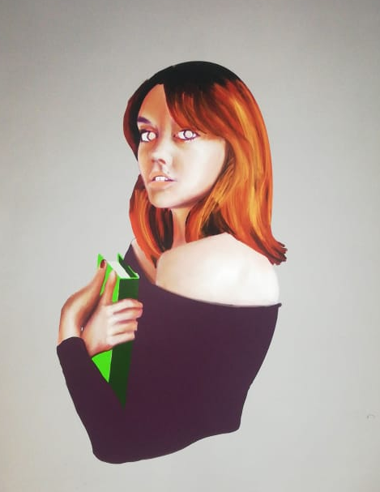
Additional Concept Art

Slide 7
Clarence

Slide 8
Chef

Slide 9
Amilia’s Mom

Slide 10
Michelle’s Mom

Slide 11
Sai

Slide 12
Investigator

Slide 13
Toni (Chelle’s Dad)

Slide 14
To Hear her Music
( 2007 – April )
“Chelle …”
“Chelly! Where are you going?”
“I’ll come over tomorrow Em’. My dad’s coming home today!”
The wind puppeteered her hair gently as she ran into the open field. Michelle’s legs carried her further and further away until her entire body had vanished into the horizon. She had a knack for disappearing, perhaps it was her talent.
“Who were you talking to Amelia?”
She held her breath for a moment before she softly answered his question.
“Chelly…”
“I thought your mom said you weren’t allowed to play with Michelle anymore.”
“I wasn’t.” She stared intensely at the ground. The bright green blades of grass stood mournfully bent over. “The whole world stops dancing when she leaves Clarence, and that makes me really sad. So, I followed her here… To hear her music for a little longer.”
Clarence yawned, opening his mouth wide enough to swallow the entire sky. “I don’t understand what you’re going on about.” He stretched his hand towards her with a glittering smile. “Does this mean I get to walk you to your dance practice?”
“Mom said no one’s allowed to watch me dance.”
“Okay then how about… You don’t tell your mom I walked you to your dance lesson, and I won’t tell her that you still play with Michelle.”
“Fine, but you’re carrying my bag.”
A giggle slipped from Clarence’s throat, “Cool.”

Slide 15
Dad’s Coming Home!
( 2007 – April )
Michelle ran as fast as her legs could carry her, barely able to contain her excitement. It was as if she was running on air. There was no friction to hold her back, and the warm throbbing in her joints had become the rhythm to the song in her heart.
“He’s home. He’s finally home!”
She leapt over the peak of the grassy hill, letting out a little squeak upon seeing the unfamiliar car in her distant driveway. “He’s really back!”, she thought to herself, as she glided down the hill.
“You have every right to hate me Priyanka – I deserve that.”
“You deserve more than that Toni!”
She was furious. She wanted to deny it – to call him out for lying – but he wasn’t. His eyes, his presence - God, even his stupid corporate tie! There was no more love here. This was a business meeting.
“Get out.”
“Priya, try and un- “
“No Toni. Take your shit and leave. You’ve broken enough today, I don’t want you hurting- “
The door burst open like a crack of thunder.
“DADDY!!!”
Toni turned, his eyes wide in shock. It was the first truthful emotion he’d worn all day. “Mi-Michelle? You’re home already?”
She flew onto him, throwing her arms around his neck. “It’s really you Daddy!”
“Yeah, I-… I guess it is,” he said with forced smile.
“Why don’t you tell Chelly what you were just telling me, Toni?” Priyanka spat the words out like poison.
He looked down at her enormous smile. It was so bright that it hurt. He averted his eyes.
“Tell me what, Daddy?” Chelle asked eagerly.
Priya sighed seeing the pitiful look on his face. Chelly didn’t have to get mixed up in this – this was their mistake and so it was their burden to bare. She walked over gently, uncrossing her arms.

Slide 16
“Chelly, Daddy’s decide to move to the city permanently.“
Chelle turned back to her dad, who was looking at Priyanka with a lost expression. “We’re moving to the city?” Chelle asked, a little uncertain. “Does that mean we get to stay with you now?!”
“No, Chelly. I’m- “, he hesitated. “I’m moving out there for my work.”
“Oh, okay.”
There was an awkward pause.
“So-oo, now, when you visit us, it’ll be more like a holiday for you!”
“Yeah, uh, I guess so.”
How did she ever fall for this coward? “Chelly, Daddy’s moving really far away this time. I don’t think he’ll be able to visit for long while.”
“Oh.”
It was as if she’d been deflated. Tears welled up in her eyes. Toni couldn’t stand to see it. “But listen kiddo, I’m gonna start writing you – at least once a week. That way I can tell you about all the crazy things that happen in the big city!”
Chelle lifted her chin, her eyes filling with hope. “Crazy things?”
“Yeah, who knows what I’ll find out there? It’ll be our new adventure to share.”
Chelle seemed a little less distraught. “Tell you what, why don’t we start now?” Toni yanked up his briefcase, and scrounged around in it for a paper and pen.
“D-ea-r Che-ll-y,” he read out as he wrote. Chelly giggled wiping away the tears.
Priya was lost for words. He had such a way with her. She wanted to believe him, but how could she after what he’d done.
All she could do now was pray that he’d keep his promise.

Slide 17
First Kiss
( 2010 – June )
Mrs Gomes glared furiously at her daughter. Tears simmered over Amelia’s cheeks as they quickly turned to mist.
“I told you to stay away from her! And now look at what she’s made you do!” Amelia’s mother turned to look at Michelle. “You disgust me. Girls like you are destined to rot in Hell! You are nothing but poison Michelle, and I don’t want to see you anywhere near my daughter. If you so much as even look at her ever again … So help me God I will Kill you.”
“No, mom please, it was a mista-” A roaring thwack resonated from Amelia’s face as Mrs Oak silenced her. The shape of her mother’s hand was now branded into her cheek.
Michelle’s body, quivering, lifted itself up. Strands of her hair floated in the air. Her bottom lip was raw and exposed; burnt skin hung off of it as her cold eyes hissed at Mrs Gomes.
“Bitch!”
“What the fuck did you just call me?”

Slide 18
Our secret spot
( 2011 – December )
“Pull!”
A dented tin can went flying into the golden sky. The sun shimmered off it for only a second.
“WHOOSH!”
“What did those cans ever do to you, Em?” asked Clarence, without looking up from his book.
“Pull!” she shouted, less ignoring Clarence and more not hearing him at all.
The fireballs had been getting more and more intense – that last one leaving hardly any trace of can at all. “Chelle, I said pull!”
“Look, Em, I’m all for pretending these tin cans are your mom’s face, but I’m getting a little bored of being your catapult.”
“You don’t get it Chelle! That bitch went too far this time.”
“Yeah, yeah – just like the last three times.”
“Chelle, I’m serious! Look at what she did to me!” Amilia gestured to the small bald patch behind her right temple.
“I dunno Em, I like you’re new hairstyle. It really stands out, you know?”
“Are you kidding!? This constitutes abuse! That bitch thinks she can get away with anything when my dad’s away. Well, we’ll see about that! I’m not backing down this time!”
Chelle chuckled. “We should shave that side of your head! That’d teach her!”
Now she was laughing outright. “Man, I wish I could see her face after that!”
“Chelle, this isn’t a freaking JOKE!”
As if punctuating her outrage, the little pile of cans erupted into a bright white inferno.
“Play nice Chelle,” Clarence chipped in. “This isn’t the time for kidding around.”
“Oh? And when is the time for kidding Clarence? You and Little-Miss-Perfect are always so damn serious.”
“We’re too serious?! Are you for real Chelle?? How can we not take this seriously? My mom is literally abu-“
“’My Mom this’ and ‘My Mom that’, I’m so tired of this crap. At least your mom takes the time to look your way.”
The breeze stopped. Chelle’s words lingered in the still air. Clarence feebly looked up from his book. “C’mon guys, take it eas-“

Slide 19
“I can’t believe you. You think this is about YOU?”
“Oh no Em, how could it be? I’m clearly not the main character here. I’m so sorry if you thought I was trying to take your precious lime-light away.”
“You’re just like her.” Em whispered, shocked at the realisation.
“I guess I am, because you disgust me.”
Clarence remembered he had a voice. “Em, Chelle didn’t mean to-“
“No. She did.” She turned, the sun glinting in her frustrated tears for only a moment. And then she ran, leaving charred footprints behind.
Chelle stood up.
“Chelle, what the heck was that about?!”
“Lately she’s been nearly as boring as you, Chunky.” Chelle chirped, walking away.

Slide 20
The Party
( 2011 – December )
2011 – A day or two earlier.
I’m not sure if the prequal piece that would be here is necessary – please tell me. I possibly want to write a piece where Em prepares for the party excitedly, spending a long time making her hair just right (upping impact of next piece). I envision some really nice shots of her prepping in the mirror for the comic.
It can be one of those times where you told your parent about an event, but then the day comes and they’re being unreasonable. So imagine her mom comes home, sees her and goes
“Good, you’re ready for practice.”
“Tonight’s the party though, Mom. I told you about it last week.”
“Oh. Well, I didn’t realise it was on the same day as rehearsal.”
“But you said I could go!”
“And now I’m saying you can’t. Get your shoes and head to the car.”
…and then the argument starts, but we skip the meat and potatoes of it – jumping straight to the piece below.
“WHO DO YOU THINK IS RESPONSIBLE FOR YADDA YADDA, ANGRY CRAP!?”
I won’t keep lying down and taking this.
“WE DO SO MUCH FOR YOU AND YOU WASTE EVERYTHING WE BLAH BLAH ANOTHER GUILT TRIP!”
I’m not backing down. Not this time.
“UNREASONABLE, ANGRY, ABUSIVE, SADISTIC BULLSHIT!!!”
One day you’ll eat your fucking words bitch. One day, when I leave this fucking shit hole. Then you’ll be sorry, you fucking- fucking- FUCK!
Amilia took a breath. For the first time in the last few minutes, she listened to the crap her Mom was spewing.
“You’re worthless Amilia. Go to your stupid fucking party then – go and waste your life with those useless SHITS you think are your friends.”

Slide 21
“I’m sure you know a lot about being a useless piece of shit.”
The words were so quiet that they’d barely left her lips. Amilia turned and began to storm out – until she felt the fingers in her hair.
A hard yank sent pain across her scalp. Amilia fell back, suddenly helpless to her Mother’s firm grip.
“Defy me. Fine.
Waste our time and talent. I couldn’t care less.
But don’t you ever – EVER – fucking talk to me like that.”
Amilia felt the ball of her Mother’s foot on her back. “No, wa-“
SHHRIP!!
She lay on her hands and knees. Her scalp was on fire. She felt the warm blood trickle over her eyebrow.
Her Mother stood over her – white knuckles filled with hair.
“Go to your party. Get the fuck out of my house.”

Slide 22
Two brothers
(Chef’s insecurities)

Slide 23
Arcade, Pt. 1
( 2012 – January )
“No Em’ You’re doing it all wrong.” Clarence’s face was covered in frustration.
“Clarence, what do you want me to do?” Amelia spoke softly.
“Okay look, you have to dodge the lightning bolts, vault over the pit and then shoot a giant fireball at the evil wizard.”
“I tried that already…”
“No Em’ you’re pressing the wrong buttons!” His fist slammed one of the yellow buttons on the cabinet. “See, Fireball.”
Amelia’s face illuminated as she stared at the glowing screen. “Okay Clarence, why don’t you play instead?”
He looked at her face, “But… Its your turn.” Her eyes looked heavy.
“No really, you can take over. I don’t even understand this game anyway.” She pulled away from the machine and placed her palms on the glass behind Clarence. She pushed the tip of her nose onto the glass and stared down at the sea of prizes below her.
Amelia put 2 tokens into the claw machine and pushed START. Clarence pressed his back against hers. He placed his hands on the controls of the game entitled “Eidolon” and picked up where she left off. Amelia’s head hung forward. Clarence could tell something was wrong; Amelia always kept perfect posture.
“Em’… What do you mean you don’t understand the game? You learnt all the controls really quickly.”
“I… Understand how the game works.” She lost control of her left hand as she spoke. The large Squirtle she had lifted up with the claw fell back into the pit. “I just don’t get it. Why is this ghost so mad at the green wizard? And what makes him so evil anyway… the ghost went into HIS castle after all.”
“Well you see the Ghost is cursed, she used to be a beautiful princess made of flames. Kinda like you Em’”

Slide 24
Amelia paused for a moment. She stood up straight and rested her spine against his. She could feel his heartbeat through his back. The beats were fast and erratic, growing more and more powerful with each passing second. She remained quiet for some time. His heart was now beating so strongly that she could feel it in her own chest.
She smiled “Princess? No way I’m a Princess. Princesses are smart, and funny, and brave, an-…”
“And beautiful!” The words erupted from his mouth.
“Yes, and beautiful. So you see that’s nothing like me.” She managed to pick up a large plushie piglet with the claw machine. The piglet had tiny black boots and a leather Jacket. The hair on his head was shaven into a short white undercut.
Clarence sighed heavily, “But you are be-…”
“No Clarence, the girl you’re thinking of is Chelle. I’m not your princess. I never will be…”
Silence resonated throughout the arcade. Clarence’s heart had stopped beating. His back became cold and rigid, like a wall made of marble.
Her heart fell as the pig dropped into the shoot; it was hers now. Amelia’s heart sunk deeply. ‘Why did I say that’ she thought. “uhm… so, anyway. I don’t understand why the green wizard is so evil.”
Clarence stared lifelessly at the screen. “ … Well, the Wizard stole the princess’s memories and then tricked her into working for him, so that he could rule all of the kingdoms. But one day she got lost in a forest and a huntsman found her and told her to look for the spirit of the wind. When she found the spirit she regained her memories and remembered that the spirit was her friend. She tried to speak to the spirit but the spirit saw her as a threat and put out her flames. After realising what she had done the spirit ran away, and pretended like she hadn’t seen the princess. So when the wizard found her, her resurrected her not knowing that she had regained her memories. And now the ghost is trying to get her revenge, on the wizard AND the spirit…”

Slide 25
“Revenge?” she bent over to claim her reward. “If you ask me, the Princess Ghost thingy is just as bad as the wizard guy. The Spirit is pretty bad too.” She held up the piglet and stared intensely at the its lifeless eyes. “The huntsman seems pretty nice though.”
“He gets killed by the Wind spirit.” Clarence spoke quickly. The piglet fell out of her hands.
“Oh…” she stared at the creature, now resting on the floor. “Clarence, I didn’t mean to upset you or anything I just…” she picked up the piglet and placed it into his hands. “Here, I won this for you.” Her face was lathered with shame.
He fondly caressed the toy piglet. “You don’t need to apologise Em’. You’re right.”
“I am? What am I right about?”
“The princess is evil too. They all are…”

Slide 26
The Horror from Blacknight Lagoon.
( 2012 – February )
The lights were out. The clinical glow of the fish tank gave an eerie life to the living room. Chelle’s keys on the countertop were like thunder in the empty house.
Mom was out again.
She sighed, then walked over to the fridge. At least there was some leftover pizza today.
She threw off her jacket and shoes to the microwave’s symphony, getting back to the kitchen just in time for the climax.
Falling onto the couch with her perfectly heated meal, Chelle stared absently at the aquarium. “Looks like it’s just us tonight, Fishstick.” The orange fish eyed out Chelle expectantly.
“What, you also want a slice?” Fishstick didn’t break eye contact. He was particularly convincing on nights like these, what with that intense glare of his.
Chelle carefully pried a mushroom free from the cheese and tossed it to the tank. She blew the lid back just in time with a flick of her wrist. Fishstick turned toward it, but was reluctant to go and take a bite.
“Well, aren’t we fussy?” Chelle set her pizza on the floor and hung her head backward off the couch. There was a knock at the window.
She looked up, a little shocked, to see Clarence’s pale face in the window. He was awkwardly waving a DVD around…
“So wait, you gave him a mushroom?”
“He asked for one!”
“He’s a fish!”
Chelle shoved Clarence playfully. He couldn’t help but giggle at her frustration. “Did you come all the way out here just to judge my parenting skills?”
“I wouldn’t miss an opportunity to judge your parenting for the world,” Clarence laughed, “but really, things are a little heated back home right now.”
“A little heated?” Chelle inquired.
“I think my mom caught Phil beating off.”
“Ew, Gross!”
“Yeah, definitely a family meeting I don’t wanna be at. So I bailed. Good thing too, or a certain fish might have lived up to his name.”
“Oh, shut up!” Chelle laughed.

Slide 27
”Okay, check out what I rented – it’s a super cheesy horror flick from the 90’s. I figure it’ll be good for a laugh,” Clarence turned back to the tv, fumbling with the remote.
“The Horror from Blacknight Lagoon? Man, this really is gonna be cheesy,” said Chelle, sitting back as the movie started. It opened with a loud, hardly believable scream.
“Hey Clarence?...”
“Yeah?”
“Thanks.”
She scooched a little closer to him.

Slide 28
Introducing Chef: The Bully

Slide 29
The Dress
( 2014 – March )
“What the fuck Em’!”
“For the last fucking time Chelle! My name is AMELIA it doesn’t make sense for you to call me Em’ if my name starts with an A.”
“Okay Em’, I get that you’re upset about your dead cat or whatever, but did you really have to pour your damn drink all over my nice dress? What’s Clarence goanna think when he gets here… I dressed up for him and everything.”
“Your boyfriend is a twat Chelle. He’s only with you because I refused to go out with him.”
Michelle pulled her dress over her shoulders. “Em’ you’re drunk, and Clarence is your friend. Why would you say something like that about your friend? Here hold this up.” She threw the dress at Amelia and gestured for her to hold it up.
The bathroom was quiet. The loud thumps and cheers of the club seemed to fade away in this fortress of mirrors and florescent lights. Michelle stood calmly between the basins and the toilet stalls facing Amelia while she held up the damp dress. She spread her feet apart and placed her hands out in front of her chest. With her palms facing Amelia she began humming.
“Jesus Chelle, why are you naked? Where’s your damn underwear?”
A powerful gust of wind emerged from Michelle’s palms. “Just, help me dry this Em’.”
Amelia’s cheeks turned red as she softly blew onto the dress. Hot air escaped from her mouth onto Michelle’s dress.

Slide 30
“Here,” Amelia tossed the dress at her face “It’s all dry now. And just so you know, I am not drunk yet.”
“Is that so? And here I was thinking that you were only staring at my body like that because of the alcohol.”
“N-no I wasn-“
Michelle pushed Amelia onto the floor, her back now rested against the wall. Amelia watched as she pressed her hand against the wall behind her. Her nude chest now rested right in front of her. Michelle could feel a warmth on her breasts emanating from Amelia’s face. “Sure you weren’t. I do wish you were though, sometimes it feels like you’re actively stopping yourself from looking at me...”
“I. I don’t want to hurt you again…”
“No need to get so flustered Em’, I just tripped Afterall.”

Slide 31
He’s not who you think he is…
Chelle’s mom reveals truth about letters
( 2015 – September )
Canonically has no matric.
Getting really good marks up to this point. (doesn’t try or care. Em has to work really hard to get great marks)

Slide 32
Michelle Leaves
( 2015 – September )
“Chef?” she stumbled into the dimly lit corridor. Her voice echoed through the halls. “Chef!” her voice continued to call as she staggered into darkness. She watched as her arms banged against the red door. “Che-… Arno?” pausing for a moment she pressed her ear against the door. She could here movement. “Arno for fuck’s sake! Open this fucking door!”.
A loud snap erupted from the latch. Michelle fell into the room slowly as the door creaked open. A lean young man stood with his back against the wall. He watched as Michelle pulled herself off of the ground.
“Some help would be nice Chef!”
“What do you want Tinkerbell?”
“Stop Calling me that my name is Michelle.”
“And my name is Arno, so please stop calling me Chef.”
Her eyes locked onto his. They were emerald in colour, with flares of electric green bursting outwards. He stared back at her with a gentle gaze.
“What are you doing here Chelly? Is everything okay?”
“No Arno… nothing is okay.”
He walked her into his apartment. She clenched her shoulders and decided to sit on the sofa, in his incense scented Livingroom. The apartment was small but pristine. Everything he owned had its place, and nothing was out of place. Even Michelle was exactly where he wanted her to be.
She could see the entire city from that sofa, from Carlton Centre to Brixton Tower, everything seemed so small.
He sat down next to her and stretched his arm around her shoulder. She rested her head on his chest.
“Everything’s so fucked up.” Tears spilled from her eyes.
“Why are you here Chelly?”
“I need you Arno!”
“Why me? Why not Amelia or Pissface?”
“Fuck Chef, do I need to spell it out for you?” her back turned cold as a gentle breeze emanated from her skin. She clawed her fingers deeply into his chest.
“I love you Arno…”

Slide 33
A jolt of electricity struck his heart suddenly. He held Michelle tightly and rested his lips on top of hers. Her lips were cold and soft; his were tender and warm. A powerful force began flowing between them as they kissed. Hot air lifted their hair. Bright green flashes of electricity danced around their bodies. The power of the elements emerging from their skin intensified as they undressed one another. Fierce bursts of energy resonated throughout their bodies as their naked skin touched.
Tears started pouring out of Arno’s eyes. He squeezed Michelle lovingly as his tears joined with hers. He hugged her passionately before, tenderly pushing away from her and staring into her dark almond eyes.
“Chelly, I love you too… you know that right? You’ve known the whole time right?”
“Yes of course I do Ar-…”
“So why now Chelly?!” his tears dripped onto her breasts. “Why did you pick now to break my heart?”
“Wait, what are you talking about?”
“You’re leaving right? You were gonna leave town in the morning weren’t you?”
“You used your power to read my mind! I fucking told you that I love you Arno.”
“I’m not Amelia or Clarence Michelle. I’m not your Damn toy. You can’t just play with my emotions like you do with theirs”
“Arno, I… I want you to come with me.”
“That’s a lie Michelle. Just sleep here tonight okay. You can take the money you were gonna steal from me in the morning.” He dried his eyes with his pants before getting dressed. “And don’t you ever go anywhere near Amelia again.” Arno opened the front door as he pulled his shirt onto his torso.
“Where are you going?”
“Bye Michelle…”
“I said I fucking love you Arno. Did you not hear me?”
“Those are the truest words you’ve ever spoken Michelle…”

Slide 34
The Note
( 2015 – September )
A cool breeze danced through his window swaying the curtains and left note on his desk. The wind caressed his face, kissed his lips then disappeared into the night. Her head was heavy with guilt as she knew she never really loved him and that her words would pierce his heart like an icy breeze, gentle in form but sharp to the touch.
The warm morning glow filled his room as he woke up and got ready for the day. Underwear, socks, shirt, pants then shoes. As he was finishing his morning routine with his tie, he noticed the folded piece of paper on his desk which had a heart scribbled on it. He smiled because it had been a long time since he last got a love letter from Chelle. He tightened his tie put on his blazer and stuck the note in his pocket. “I’ll read it later.” He thought as grabbed his kit bag and backpack.
The day was long and busy, he didn’t get a chance to hang out with Em or Chelle. After school he messaged Michelle “Hey babe, where are you?”, but the text wasn’t going through. His phone buzzed with a message from Amelia,
“Can we walk home together and grab a coffee? ☕” 14:16
“Sure, meet me at the front gate. 🐦” 14:17
“Cool see you soon! ❤” 14:17
They met at a large steel gate which now had an obnoxious billboard on it advertising a restaurant and real estate agency:
Potgieter Pots and Plots,
Kom geniet ons tuis gebak en jou nuwe droom huis ontmoet.
Clarence looked at the sign in disbelief, “They really know how to make it hard for me.”
“Oof, sorry Clarence that’s rough.” Amelia said with a chuckle. A cool breeze blew that afternoon as they walked together. They spoke for a while when Amelia remembered something.
“Hey, Clarence, have you seen Chelle today?”
“No, I haven’t Em, I thought she was with you?”

Slide 35
“I’ve been messaging her all day, but the texts haven’t been going through.”
“Ja the same with me, but she left me a note this morning.”
He took the note from his blazar and opened it. The wind whistled through the trees and past Clarence making the paper flap in wind, but he held it firmly in his grip.
“What does it say?” Amelia asked while fighting the wind to brush her fringe out of the way, but Clarence didn’t respond he just stood there, frozen. Amelia came closer and put her hand on his Shoulder. “Clarence?”
She grabbed the note from his hand, read it then reread it over and over. The wind stopped and the air fell silent. Amelia could feel her chest tightening as the air thinned around her, she started to cry but no sound came out at first. Tears trickled down her cheeks onto the note obscuring the writing. Amelia scrunched the note tightly and choked, “That Bitch!” The note in her hand turned to ash in a flash of fire, and her tears evaporated from her cheeks.
Clarence snapped out of his daze when he saw Em going ablaze with rage. He pulled her close and hugged her tightly, black smoke rose above them as their clothes began to burn from her flames. It hurt but he refused to free her from his embrace as she struggled against him screaming all the while for him to “let go!”. Her flames died down as she succumbed to his hug, her voice broke and she cried out. “Why did she go?”
“I don’t know...” Clarence’s voice began to waver.
“Why didn’t she say anything?”
“I don’t know…”
“Clarence I’m sorry.”
He hugged her tighter as his façade began to buckle “It’s okay Em. You didn’t burn me as bad as last time.”
Michelle’s Note which can be only be viewed through the AR app:
Clarence I’m sorry, by the time you’re reading this I’ll already be long gone. I couldn’t stay in this town anymore it was killing me. I didn’t know how to say goodbye because I know you’d try to stop me.
So Goodbye…

Slide 36
Late Night Arcade
( 2015 – September )
Chef checked his phone for the 8th time.
10:24 PM.
He looked over at the feint glow around the corner. All the other machines had already been shut down for the night, but the 8-bit soundtrack of Eidolon bleeped on.
“C’mon matchstick, some of us have lives to get to.”
No reply.
He sighed, reluctantly stood up, and sauntered over to her. “If you aren’t outa here in the next two minutes, I’m locking you in.”
He leaned on the old machine, less annoyed than adamant. Her moping here helped nobod-
He saw her face for the first time today. Deep burns trickled down her cheeks, as if her tears were molten silver.
“Jesus Em…”
“Arno, please…”
She never called him by his name. Fuck, she was a mess! “Em, what’s going on?” How could he tell her that he already knew? No, she had to tell him herself.
“Please, Arno, just – just leave me be.”
He contemplated the idea, then silently turned away.
His eyes widened in shock as soon as they met hers.
“Jesus Em…”
He was looking at her so pitifully. She felt naked in his gaze.
“Arno, please…”
Please go. Please just go!
“Em, what’s going on?”
She couldn’t do this now. She could feel her heart boiling over. If he kept pressing her, she’d burst. She looked back into the screen – it was all she could do to keep from sobbing.
“Please, Arno, just – just leave me be.”

Slide 37
He lingered for only a moment more, then turned and left without a word. Thank God. She tried to focus on the game again. She’d been fighting the wizard for the whole freaking afternoon. A door clicked somewhere in the distance. She placed her hands meekly back on the controls. Weren’t video games supposed to be some sort of escape? Why couldn’t she get her head in the game? The fluorescent lights went out. Why couldn’t she forget?! She squinted through her blurred vision, ready to un-pause the frozen machine, when realisation hit her.
She leaned left, looking out at the barren arcade. Shit, had Chef actually locked her in?
She was still deciding whether she should care or not, when the chair next to her creaked. Chef was busying himself, navigating to the multiplayer mode of the game.
“Chef, what-“
“If you aren’t gonna tell me, I’ll just have to beat it out of you,” he said, without turning to look at her. “You play the princess, right?”
Why wouldn’t he leave? Why was he being so persistent? What did she have to do– to make him– to–
Her dam burst, tears washing away any façade she was still desperately clinging to. She buried her face in his shirt and wailed.
Chef was taken aback for only a moment. He leaned over her convulsing body and lightly ran his fingers through her hair. He understood too well what she felt, but he didn’t know how to make the feeling go away. All he could do was ease the pain of her sobbing. Gentle sparks danced through her curls.

Slide 38
The Bed
( 2015 – December )
Part I
January 2016
13:01
The sunlight reflected off her eyelids. Her entire body simmered in the afternoon sun. She could feel something rigid digging into her spine, and could hear the electric crackling of bacon on the stove.
Suddenly, her face was covered in shade, the red colour that she saw bouncing off of her eyelids had now turned black.
“What the Fuu-“, her voice was muffled as a tremendously large pillow fell on her face.
“Wake the hell up already!” Arno stared at her as her torso arose from the couch. His hand moved swiftly as he stirred and tossed the bacon from side to side. The aroma of spring onion and bacon flowed around the brightly lit cottage before entering Amelia’s nose.
“Smell’s good Chef” a smile escaped her mouth. Arno enjoyed seeing her smile, but these days her smile was rare.
“Oh shut up already; It’s bad enough I have to hear you talk while you’re asleep. And I told you to call me Arno.”
“Well Chef, I think that name suits you better.” She pulled herself over the back of the couch before falling onto the floor. “And I don’t talk in my sleep you liar!”
“Ha ha- Yeah right!” Arno’s eyes widened as he laughed. “You were all like Oh Chef I love you so much mwah mwah mwe…”
“Get over yourself Cheffy and finish making my breakfast.” She pulled a strip of bacon from the pan and absorbed the heat into her skin. Her hand shot upwards as she threw it into the air before catching it with her mouth. “And for the record I wouldn’t be caught dead kissing you.”
He smiled devilishly, “Who said anything about getting caught?”
His hand reached into the cupboard and pulled out two plates. He dished up two fried eggs for himself and three for Amelia, then he placed crispy rashers of bacon next to them. He dropped two slices of golden toast onto each plate. His fingers gently added a lean piece of boerewors to each plate before peppering the eggs and glazing the bacon in honey.
“Order’s up Princess.”

Slide 39
“Thanks man this looks delicious.” she grabbed her knife and fork and stabbed the wors.
“Woah! Hold on. We need to pray first.”
“Oh so you’re religious now?”
“It comes and goes” he shrugged before making the sign of the cross. “God, bless our food and -…”
“And make us good, Amen!” her voice echoed throughout the room.
Arno smiled and began eating.
“So what are you doing today?”
“We are gonna find you a job Em’.”
“A job, why?”
“Because you’ve been freeloading for over a month now, and you need to learn to be a responsible adult who fends for themselves.” The fork in his hand pierced the air in front of her nose as he spoke to her.
“Says the boy who lives in his parents back yard.” Her eyes rolled.
“Look, I don’t mind you staying here Em’. I really appreciate the company, I just don’t think its healthy for you to be cooped up in here all day.”
“Fine, I’ll get a job…”, she slammed her hand onto his, gripping tightly and staring into his surprised eyes. “I wanna go to work with you!”
“What, at the arcade?”
“No, eww”, she shook his hand with her own before stealing a streak of his bacon. “I wanna work with you. You know, doing the other thing.” Food flew out of her mouth as she spoke.
“I don’t know what you’re talking about Em’”
“I’m not an idiot Chef, I know you sell Dank.”
“Sh- shhh- shhhh- Ok, okay. You can come to work with me.” He watched her for a moment. His heart melted as a large smile formed between her cheeks. He smiled back at her.
Her heartbeat started accelerating as ghe smiled at her “What’s that smile about Mr Arno?”
“Oh, it’s nothing Em’.”
“Whatever weirdo, gimme your plate so I can wash it.” Their plates were both empty, hers smudged with various sauces, and his stainless. “Oh and Chef…”
“Yeah Em’?”
“I’m sleeping on the bed tonight.”

Slide 40
Part II
January 2016
21:05
“Okay Em’ stop playing that stupid game, I’m locking up”
“Hold on I’m fighting the wizar-…”
The blue light from the screen vanished as Amelia was about to land the killing blow.
“Chef! I was about to kill him!”
“What did that poor wizard ever do to you Em’?” He quickly filled his backpack with items from behind the arcade counter. “Anyway, it’s time to work.”
“What, where gonna sell dank now?”
“I don’t sell weed Em’, I sell information.”
“What kinda information?”
A devilish grin appeared on his face. He moved slowly towards her. Sparks or electricity shimmered in his green eyes. He placed his hand in hers. She could feel a pleasurable tingling sensation traveling up her arm as he touched her. Her heart was beating so hard it felt like it was going to explode. Their faces were close now; close enough for her to taste his breath. He closed his eyes and leaned forward.
“Nice try Cheffy” she made sure her hot breath entered his mouth before she punched it out of him.
“Damn girl! If I knew you could punch like that, I would’ve made you my bodyguard ages ago.”
“Yeah yea, save it for the other girls Charmer Boy. So what are you gonna do with that camera in your bag anyway?”
He smiled widely revealing his razor-sharp canines “Let’s go princess.“
22:30
The two of them stood in an alleyway between the two massive houses. The one on the left belonged to commissioner Habib. There was a silver Lexus parked outside the house, next to a black Range Rover wrapped in police insignias.
“Chef, what are we doing at Sachin’s house?”
“Sachin’s mom is the Commissioner of police around here.”
“Yeah and his dad is a pilot who travels a lot, what’s your point Arno?”
“You wanted to come to work with me right? So take this camera, climb up to that balcony and take pictures Em’.” The camera flew out of his hands and towards her.
“Fine… “

Slide 41
Arno began fiddling with the door on the Lexus, “Oh and Em’…”
“Yeah?”
“You have 90 seconds before this car’s alarm goes off”
“Shit!”. Her body moved before she had time to think. In a single manoeuvre she had launched herself into the air in a burst of flame. She was now on a balcony three stories above the street. Arno gazed at her in awe. He was captivated by the sublime nature of her. Her sheer power made him feel insignificant. Amelia looked at her legs and found that she was performing a perfect pirouette on the balcony’s railing. Embers danced off of her scorched leggings.
She took a moment to gather herself after switching on the camera. “Okay, so what’s so impor-…”. She was surprised to find her former classmate’s mother sleeping with a man that was not her husband. “Principle Mogale?” she asked herself.
“Take the fucking picture and let’s go!” Chef shouted waving the cell phone he had just stolen from the car.
“Fuck it.” Amelia held down the shutter. Several flashes bounced off of the sliding door. The two figures inside the bedroom rushed towards the sliding door to investigate. By then however, Amelia had already thrown herself off of the balcony. “You better fucking catch me!”
A flash of green light emerged as Arno dashed underneath her. Swiftly, he caught Amelia and ran into the alleyway. Her hair floated as emerald charges of electricity flowed through her body. “Ha ha ha ha!” They laughed as the car alarm started ringing.
“Let’s get the fuck out of here Chef!”
“Agreed.”
_________________________________________________________________________

Slide 42
11:59
Laughter burst in through the cottage door as they arrived home. Arno stumbled into the doorway before falling onto the floor. Amelia grabbed his forearm and pulled him up after locking the door. She spun him around before placing both of her hands on his back. She pushed him into his bedroom and closed the door behind her.
“What are you doing Em’?” he asked still laughing uncontrollably.
She said nothing and watched as he stumbled towards the bed. Laying on his back he gazed at her with his one arm resting between his head and his pillow. Amelia smiled at him and turned off the light. She unbuttoned her flannel shirt and began to undress. She walked slowly towards Arno. Her body glowed a soft orange colour. She climbed on top of him and helped him take his shirt off. Arno could feel the warmth from her open legs on top of his thighs. Once he was shirtless she ran her fingers up and down his chest, sinking her fingertips deeper and deeper into his skin. Arno’s skin emitted a tender green glow as Amelia leaned her head forward.
He melted as she softly kissed the side of his neck. She lightly squeezed his earlobe between her heated lips. Before whispering sweetly to him.
“I told you I’m sleeping on the bed tonight.”

Slide 43
Coffee For Rob!
( 2016 – December )
“Rob! Coffee’s up!” Chelle called, lost in thought.
Sure, this was a pretty sweet gig, but she couldn’t afford to get lost in this routine. She’d been working 5 days a week at a new Starbucks branch, which only left her the weekends to look for her Dad. It’d been three months already, and she’d still found nothing. Frankly, it stressed her out. What if this whole pilgrimage of hers was for nothing?
She shook off the unsettling questions just as Rob arrived for pickup. She couldn’t disappear down that rabbit hole while at work.
“Hey, is this the mocha-chino for Rob?” he said, a little louder than necessary.
Michelle smiled politely. “Yup, that’s the one. That’ll be R46, 90.”
“Hello?” Rob called, uncertainly. He leaned on the counter, looking right past her.
“Sir? I said that’ll be R46, 90.” She repeated, more firmly. He stared blankly over her shoulder at the door to the kitchen.
“Hey man, you got some sort of problem with me?”
“Where are those girls – mumble mumble – gonna be late…”
“Dude, what’s with you?!” Michelle was getting ticked off now. Was this some stupid prank? The man awkwardly leaned over the counter to get a menu. He quickly thumbed through it to the page his mocha-chino was on. “mumble – R46,90…”
“I already told you that!” Michelle shouted. He fumbled through the notes in his wallet, ignoring her completely. Her mouth hung open in disbelief. He produced a R50 bill – just as Michelle’s hand bashed down on the register in frustration. It popped open.
Rob gave a little start at that, then looked around gingerly.
“C’mon man, this isn’t funny!”
Michelle couldn’t shake the impression that this man was genuinely confused. After a second or two, he picked up his coffee, leaving the R50 on the counter. “mumble mumble – long Monday – mumble – “ he articulated to himself, walking away, head shaking.
“Oh yeah, REAL Mature man! Aren’t you like in your 40’s?! Grow up dude!”
The kitchen door burst open.
“Michelle, what’s going on?!”

Slide 44
She whipped ‘round to see Rebecca’s concerned face. Suddenly, Michelle was aware that several people were glancing her way, whispering under their breath. “It’s… It’s nothing.”
“Was that a customer? Michelle, that isn’t like you…”
“I- I’m sorry. I don’t know what came over-“ she murmured. The stares around her seemed to intensify. She felt tears of frustration growing in the corners of her eyes. “mumble – early lunch – mumble mumble – “ she said, excusing herself, and pushed past Rebecca into the kitchen.
What the fuck was that about?

Slide 45
Becca’s Letter
( 2016 – December )
Michelle was sitting on the couch when Rebecca got home. She’d stopped looking surprised by the lights being on in the apartment they shared. It’d been like this for two weeks now. Michelle watched patiently as she put her things down.
Rebecca finally noticed the envelope left on the empty countertop. She carefully tore it open, confused to find it full of money, accompanied by a letter. Leaving the money where is was, she gently unfolded the letter, leaning on the counter as she read. Her brow furrowed, either in confusion or frustration – it was hard to tell from here.
She finished – probably – ‘cause now she was looking around for any signs of life.
“Michelle! Are you in here?! Can we please talk about what’s going on with you?!”
Michelle didn’t reply. There was no point in trying to – she’d already tried for the first week. At least Becca could still read the letter she’d left.
“I know you still in here Michelle, you ain’t taken any of your crap yet! Just talk to me!”
Michelle buried her face in her knees, covering her ears. She’d tried. Tried so damn hard. She wouldn’t succumb to the desperation again – her throat still hurt.
“You think this makes it okay!? Girl, fuck this stupid rent money! You can’t just drop this here and disappear!”
“It’s not like I want to disappear!!!” Michelle screamed, her voice still hoarse from her last one-sided argument.
“MICHELLE! MICHEEELLE!”
There was a thumping from the apartment below, coupled by angry mumbles. “FUCK OFF JARED!” Becca yelled, stomping hard. “MICHEEEELLE!!!”
Michelle couldn’t watch this again. She leapt off the couch and rushed towards the door.
Rebecca bolted into the living room, fuelled by her own frustration. Michelle realised too late, closed her eyes and braced for impact.
But none came.
She turned to see her new friend, still desperately crying her name into every nook and cranny of the apartment behind her. She patted her torso down, taken aback. Then she shook her head sharply and ran out the door.

Slide 46
The letter
Becca,
I’m going through some stuff that I can’t really explain, but I won’t be able to work the register like this.
I’ve left the month’s rent money with this letter (thank God we get paid by the week).
I don’t think I’ll be around for a while, I’ve got a lot of shit to figure out.
I guess I’ll see ya round.
~Michelle.

Slide 47
My Mind is my Own
Link with duel betrayal from Chef and Michelle.
( 2017 – May )
Have you been messing w with my mind this whole time?!
You asked me to.

Slide 48
It wasn’t her fault
Em’s mom realises the flaws in her behaviour.
It’s too late.
( 2017 – May )

Slide 49
He sees right through me.
(Chelle meets Sai)
( 2017 – May )
Same day Em breaks it off with Chef.

Slide 50
The light of my life
( 2019 – February )
Started dating late 2018.
She held the phone close to her face. The clinical white light from the screen pierced into the side of her eye. She stared down at an old letter addressed to her. To my dearest Michelle; from Anthony Eastwood.
“Hello?”
“Hey. “
“Michelle what’s wrong?”
“Sai… I need you”
“Michelle, where are you ?!”
“Relax I’m fine. I just can’t be alone right now.”
“Alright, I’m coming over.”
_______________________________________________________________________
Light sliced the room apart as Sai walked into the apartment. The living room was an abyss of darkness split in two by a blade of light. He glided over to the dirty sofa, turning the dust into glitter as the light followed him. Glaring intensely at the vacant couch he sat down. A large puff of dust surrounded him. Each particle being illuminated as it spun past his body. The warm sunlight behind him silhouetted his entire body. His hands were bathed in light.
Sai thrust his glowing hand into the darkness, “There’s no use in hiding my love, I can see you.”
Michelle’s body emerged into the light. She was sitting on the couch next to Sai with her palms clasping her naked elbows.
“My mom’s been in a car accident. They just called me from the hospital…”
“Your mom? You told me your mom was dead Chelle…”
“DON’T CALL ME CHELLE! That’s not my name.”
“Hey, Calm down. I’m sorry okay.” Sai swung his arm around Michelle and held her tightly. His skin was warm and radiant. Her skin was soft but cold. He could feel the hairs on is arm swaying back and forth as he held onto her bare shoulder.
“Sai…”
“Yeah?”
“I’m sorry I lied to you. I told you my mom was dead, because I hate her. I hate her so much Sai, she fucked me up and now I’m just a broken mess of a person.”
“Its in a parent’s nature to fuck their kids up darling, don’t take it personally. So are you going to visit her ?”

Slide 51
“No, she’ll be fine. That bitch is resilient.”
“Apparently you are too. Is that something that Mr Reddy has too or is that just you and your mother?”
“My parents weren’t married, so my dad isn’t a Reddy.”
“Oh … I’m sorry”
“Don’t be.”
Sai scratched his head in embarrassment. Michelle, noticing his awkwardness, wrapped her arms around him. “C’mon Sai! I wanna meet your parents.”
His eyes widened, “What Why?”
“Because I really like you, and I don’t want to lie to you anymore.” She blew herself off of the couch. A large smile flew across her face. “And that means that you can’t hide things from me either.”
“Ha ha ha, okay lets go.”

Slide 52
Michelle?...
(Meet the parents)
( 2019 – February )
“Sai, why didn’t you bring this lovely lady to meet us sooner?” Venessa Smiled at Michelle
The front door opened.
“I really should get going now, but thank you for the lovely dinner Ma’am. “
“The pleasure is all mine Michelle. Please feel free to come over whenever you’d like. It’s a shame my husband wasn’t home to meet you.”
A grizzly man entered the room. “What were you saying about me this time honey.” The grizzly man laughed.
“Oh speak of the Handsome devil, here he is. Toni I’d like you to meet Sai’s Girlfriend Mi-
“Michelle….”

Slide 53
Aren’t you tired of this crap
(Em fights Eidolins)

Slide 54
Investigator follows Em

Slide 55
Final Scene (Em)
( 2019 - February)
… I know.

Slide 56
Final Scene (Chelle)
I hate you...

